Slide 1
IBM University Engagement Project Submission
“Exploring the Power of Machine Learning with IBM Cloud”

Slide 2

Project Title – Network Intrusion Detection System
Domain of Project – Network Security
Student Name | Recent Passport Photo | Email ID | Mobile number [WhatsApp]
Anuj Navin Shinde |  | anujshinde706@gmail.com | +91 7208750324

Slide 3
Problem Statement -
Network Intrusion Detection System using Machine Learning
Modern communication networks generate massive volumes of data every second, making them increasingly vulnerable to cyber threats such as unauthorized access, denial-of-service attacks, malicious activities, and abnormal network behavior. As network traffic continues to grow in complexity, identifying potential intrusions using traditional monitoring techniques becomes difficult, time-consuming, and prone to human error.
The inability to detect malicious activities at an early stage can lead to data breaches, service disruption, financial losses, and compromised system integrity. Therefore, there is a growing need for an intelligent intrusion detection mechanism capable of continuously analyzing network traffic and accurately distinguishing legitimate communication from suspicious or anomalous behavior.
An effective Network Intrusion Detection System (NIDS) should provide reliable, timely, and accurate detection of potential threats, enabling organizations to strengthen network security, improve incident response, and maintain the confidentiality, integrity, and availability of communication networks.

Slide 4
Proposed Solution -
The proposed solution leverages IBM watsonx.ai AutoAI on IBM Cloud to develop an intelligent Network Intrusion Detection System (NIDS) capable of automatically analyzing network traffic and identifying suspicious activities.
The network intrusion dataset is imported into IBM watsonx.ai AutoAI, where the target column is configured for prediction. AutoAI automatically performs data preprocessing, feature engineering, algorithm selection, and hyperparameter optimization, eliminating the need for extensive manual model development.
Multiple Machine Learning pipelines are generated and evaluated based on their predictive performance. The highest-performing pipeline is selected and deployed using IBM Watson Machine Learning on IBM Cloud.
The deployed model is then tested using sample network traffic records to verify its prediction capability. Based on the learned traffic patterns, the system classifies each network connection as either Normal or Anomaly, enabling automated intrusion detection and supporting timely identification of potential security threats.

Slide 5
Technology Used
IBM Cloud: Provides a secure and scalable platform for developing, deploying, and managing the Network Intrusion Detection System.
IBM watsonx.ai AutoAI: Automates data preprocessing, feature engineering, model selection, and hyperparameter optimization.
IBM Watson Machine Learning: Deploys the trained model and enables prediction testing on IBM Cloud.
Programming Language: Python
ML Algorithm / Model Used: Snap Decision Tree Classifier
Accuracy Obtained: 99.5%

Slide 6
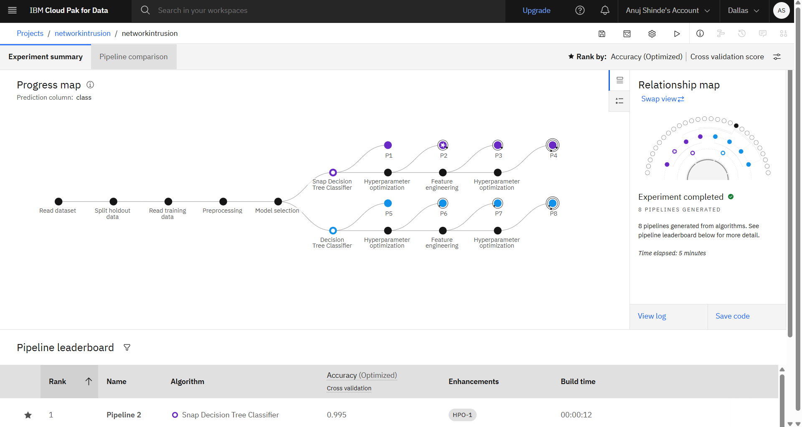
Training Screenshots-

Slide 7
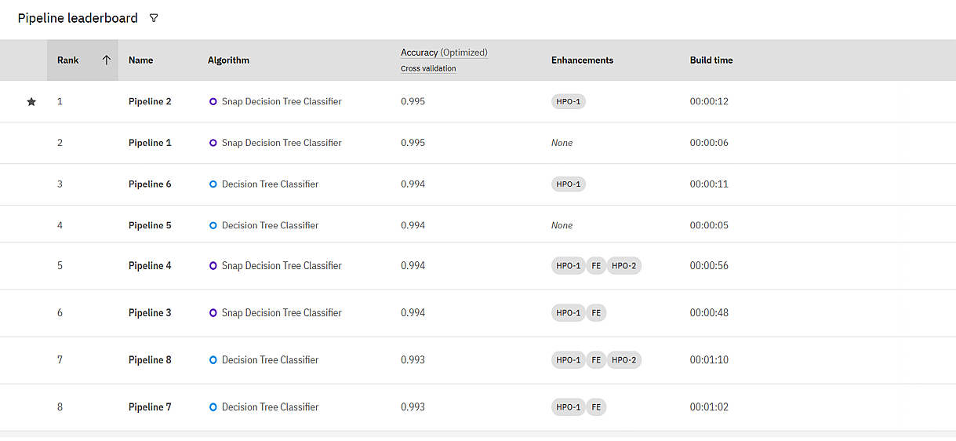
Best Model Screenshot:

Slide 8
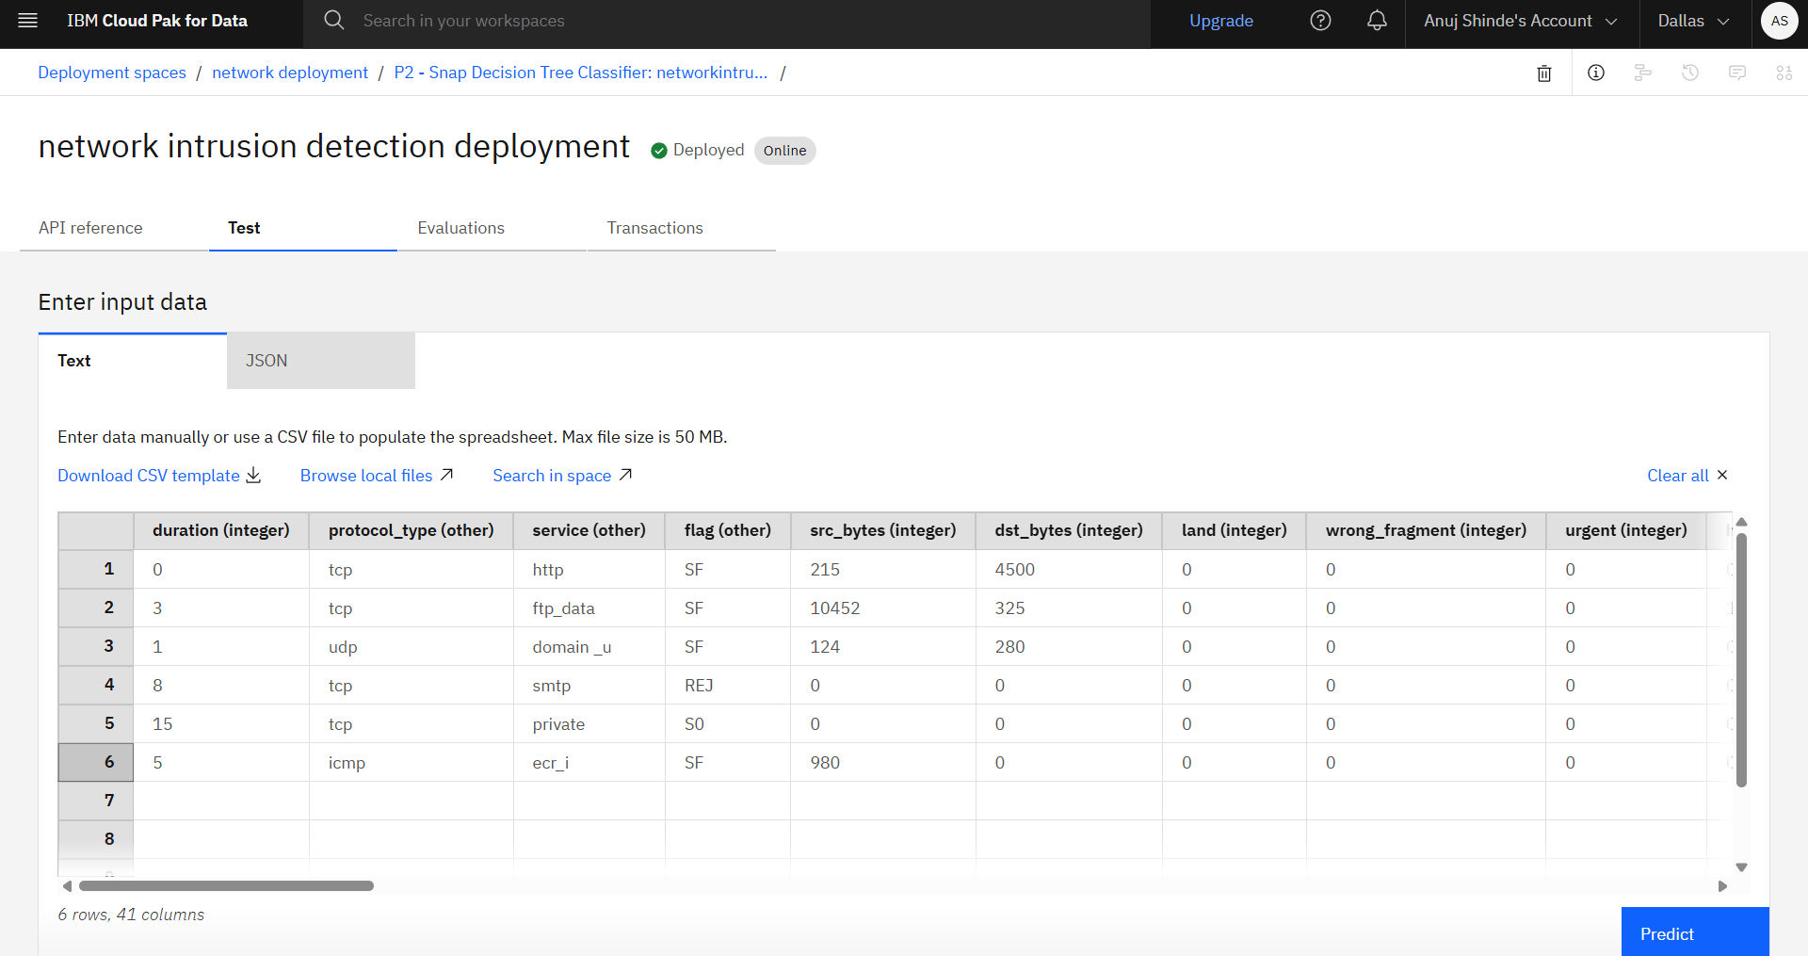
Testing Screenshot:

Slide 9
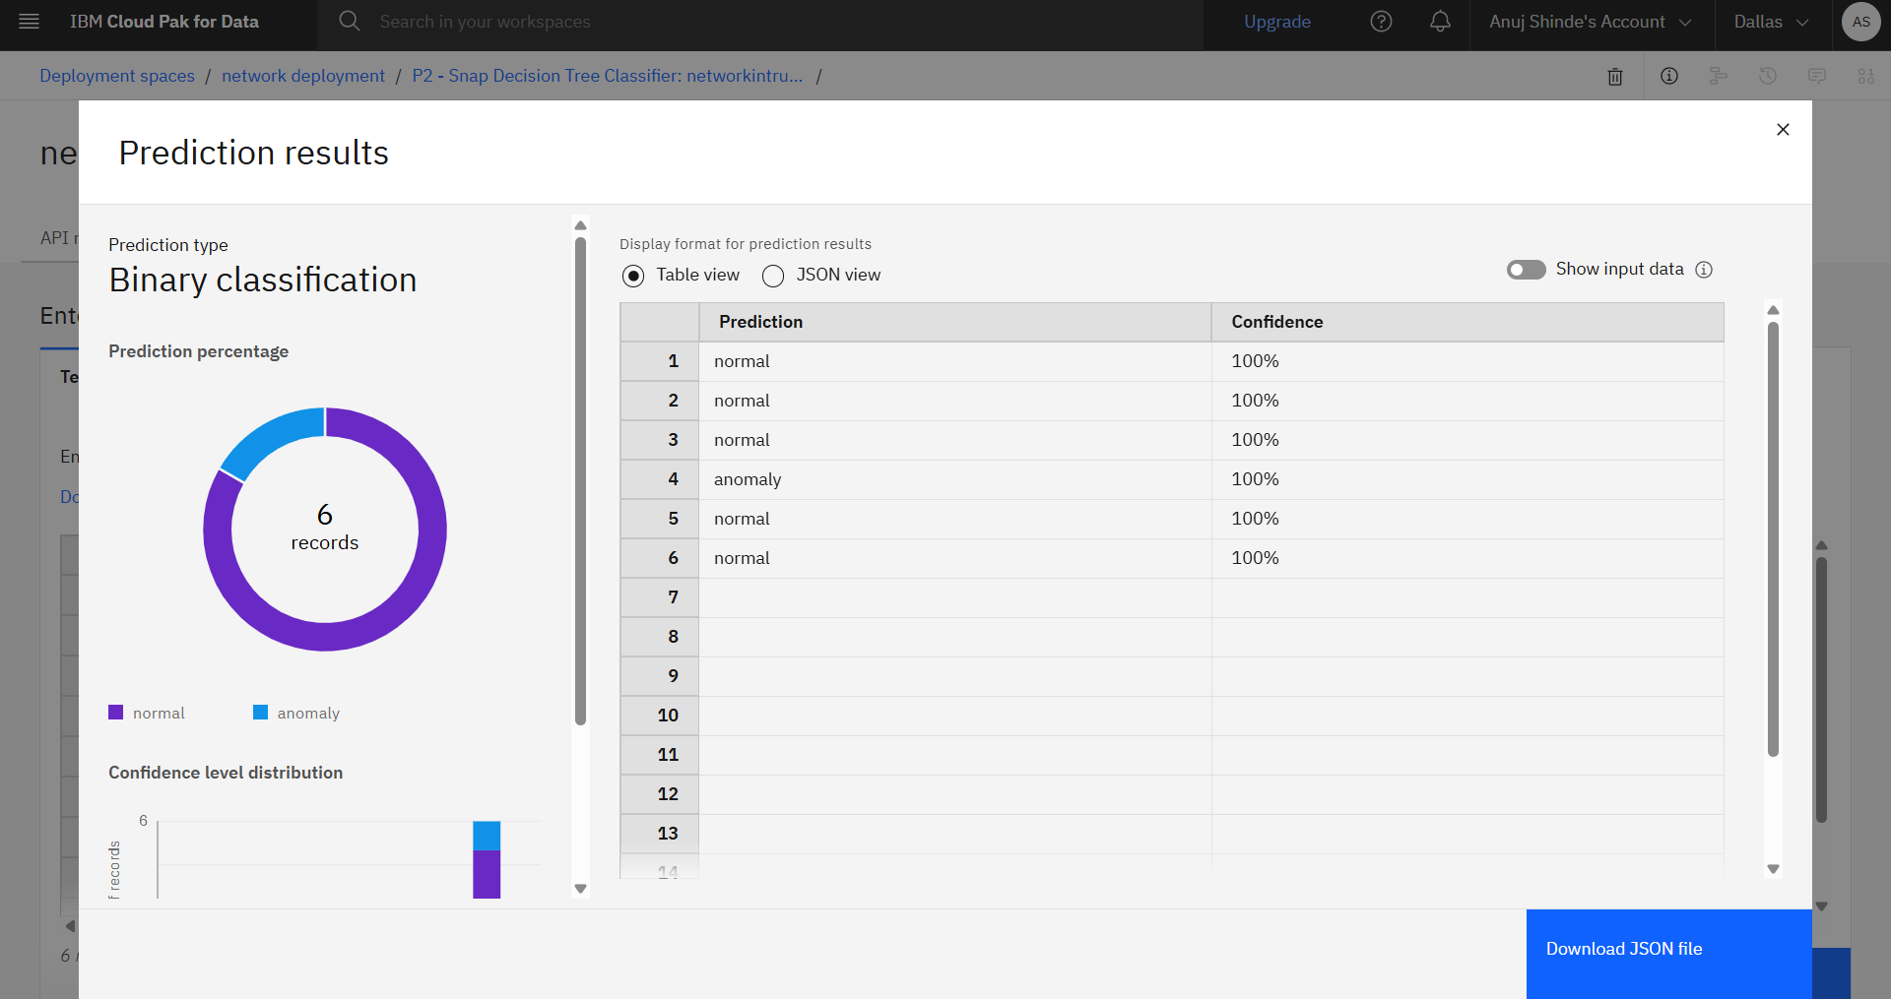
Testing Screenshot:

Slide 10
Novelty and Uniqueness
Automates network intrusion detection using IBM watsonx.ai AutoAI, reducing manual model development.
Analyzes multiple network traffic features to accurately identify Normal and Anomalous network activity.
Automatically generates, evaluates, and selects the best-performing Machine Learning pipeline.
Deployed on IBM Cloud using IBM Watson Machine Learning for efficient prediction testing.
Demonstrates a complete end-to-end AI workflow, from data preparation to cloud deployment, with minimal manual intervention.

Slide 11
Git Hub Link
https://github.com/anuj-76/Network-Intrusion-Detection-System.git
·
·
·

Slide 12
Future Scope
Extend the system to support multi-class attack classification such as DoS, Probe, R2L, and U2R.
Integrate the solution with real-time network traffic monitoring for continuous intrusion detection.
Improve prediction accuracy by training the model on larger and more diverse datasets.
Implement real-time alert and notification mechanisms for detected network threats.
Deploy the solution for enterprise-scale cybersecurity applications and cloud environments.

Slide 13

Certificates Earned:

Slide 14

Certificates Earned:

Slide 15

Certificates Earned:

Slide 16

Certificates Earned:

Slide 17

Certificates Earned:

Slide 18

Certificates Earned:

Slide 19

Certificates Earned:

Slide 20


